Slide 1
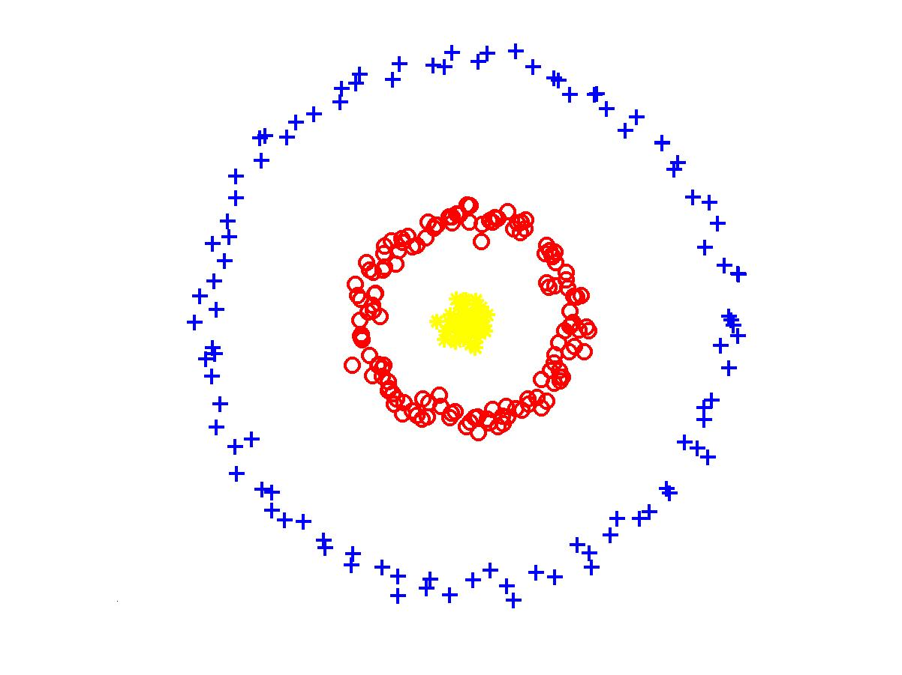
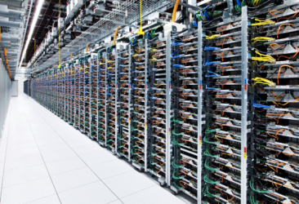
Clustering on Clusters 2049: Massively Parallel Algorithms for Clustering Graphs and Vectors
vs
Grigory Yaroslavtsev
http://grigory.us

Slide 2
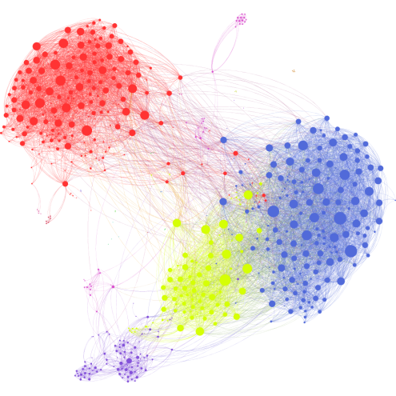
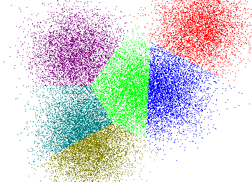
Clustering on Clusters: Overview
Algorithm design for massively parallel computing
Blog: http://grigory.us/blog/mapreduce-model/
MPC algorithms for graphs
Connectivity
Correlation clustering
MPC algorithms for vectors
K-means
Single-linkage clustering
Open problems and directions

Slide 3
Clustering on Clusters 2049: Overview
 | Graphs | Vectors
Basic | Connectivity Connectivity++ | K-means --
Advanced | Correlation Clustering Single-Linkage Clustering | MST Single-Linkage Clustering

Slide 4
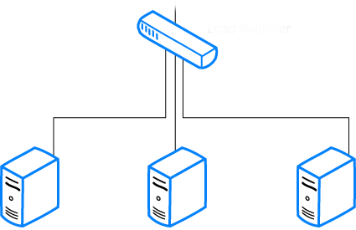
Cluster Computation (a la BSP)
Input: size n (e.g. n = billions of edges in a graph)
$M$ Machines, $S$ Space (RAM) each
Constant overhead in RAM: $M⋅S = O(n)$
$S$ = $n^{1−ε }$, e.g. $ε$ = 0.1 or $ε$ = 0.5 ($M=S=O(\sqrt{n})$)
Output: solution to a problem (often size O($n)$)
Doesn’t fit in local RAM ($S≪n$)
$Input:size n$ ⇒
$$\text{⇒} Output$$
$M$machines
S space

Slide 5
Cluster Computation (a la BSP)
Computation/Communication in $R$ rounds:
Every machine performs a near-linear time computation => Total user time $O(S^{1+o(1)}R)$
Every machine sends/receives at most $S$ bits of information => Total communication $O(nR)$.
Goal: Minimize $R$. Ideally: $R$ = constant.
$≤S$ bits
$M$machines
S space
$O(S^{1+o(1)})$ time

Slide 6
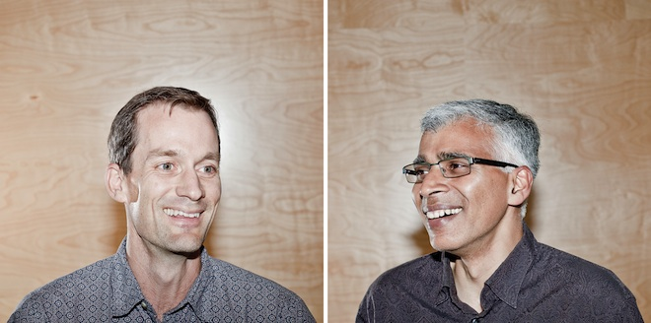
MapReduce-style computations
What I won’t discuss today
PRAMs (shared memory, multiple processors) (see e.g. [Karloff, Suri, Vassilvitskii‘10])
Computing XOR requires$\tilde{Ω}(\log{n})$ rounds in CRCW PRAM
Can be done in $O(\log_{s}{n})$ rounds of MapReduce
Pregel-style systems, Distributed Hash Tables (see e.g. Ashish Goel’s class notes and papers)
Lower-level implementation details (see e.g. Rajaraman-Leskovec-Ullman book)

Slide 7
Models of parallel computation
Bulk-Synchronous Parallel Model (BSP) [Valiant,90]
Pro: Most general, generalizes all other models
Con: Many parameters, hard to design algorithms
Massive Parallel Computation [Andoni, Onak, Nikolov, Y. ‘14] [Feldman-Muthukrishnan-Sidiropoulos-Stein-Svitkina’07, Karloff-Suri-Vassilvitskii’10, Goodrich-Sitchinava-Zhang’11, ..., Beame, Koutris, Suciu’13]
Pros:
Inspired by modern systems (Hadoop, MapReduce, Dryad, Spark, Giraph, …)
Few parameters, simple to design algorithms
New algorithmic ideas, robust to the exact model specification
# Rounds is an information-theoretic measure => can prove unconditional results
Con: sometimes not enough to model more complex behavior

Slide 8
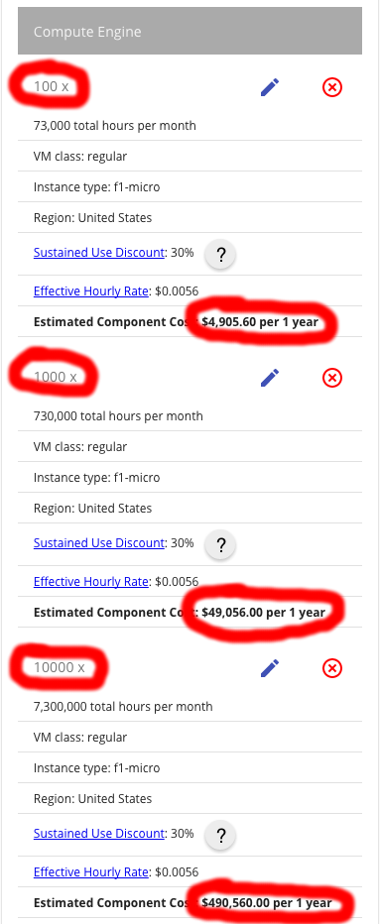
Business perspective
Pricings:
https://cloud.google.com/pricing/
https://aws.amazon.com/pricing/
$\sim L$inear with space and time usage
100 machines: 5K $/year
10000 machines: 0.5M $/year
You pay a lot more for using provided algorithms
https://aws.amazon.com/machine-learning/pricing/

Slide 9
Part 1: Clustering Graphs
Applications:
Community detection
Fake account detection
Deduplication
Storage localization
…

Slide 10
Problem 1: Connectivity
Input: n edges of a graph (arbitrarily partitioned between machines)
Output: is the graph connected? (or # of connected components)
Question: how many rounds does it take?
$O\left(1\right)$
$O\left(\log^{α}{\text{n}}\right)$
$O({\text{n}}^{α})$
$O(2^{α\text{n}})$
Impossible

Slide 11
Algorithm for Connectivity
Version of Boruvka’s algorithm:
All vertices assigned to different components
Repeat $O(\log{\text{|}\text{V}\text{|}})$ times:
Each component chooses a neighboring component
All pairs of chosen components get merged
How to avoid chaining?
If the graph of components is bipartite and only one side gets to choose then no chaining
Randomly assign components to the sides

Slide 12
Algorithms for Graphs: Graph Density
Dense: $S≫|V|$, e.g. $S≥{\left|V\right|}^{3/2}$
Semi-dense: $S=Θ(|V|)$
Sparse: $S≪\left|V\right|,$e.g. $S≤{\left|V\right|}^{1/2 }$

Slide 13
Algorithms for Graphs: Graph Density
Dense: $S≫|V|$, e.g. $S≥{\left|V\right|}^{3/2}$
Linear sketching: one round, see [McGregor’14]
Workshop at Berkeley tomorrow: http://caml.indiana.edu/linear-sketching-focs.html
“Filtering” [Karloff, Suri Vassilvitskii, SODA’10; Ene, Im, Moseley, KDD’11; Lattanzi, Moseley, Suri, Vassilvitskii, SPAA’11; Suri, Vassilvitskii, WWW’11]…

Slide 14
Algorithms for Graphs: Graph Density
Semi-dense Graphs: $S=Θ(|V|)$ [Avdyukhin, Y.]
Run Boruvka’s algorithm for O($\sqrt{\log{|V| }}$) rounds
# Vertices reduces down to $\frac{|V|}{{2^{\sqrt{log |V|}}}}$
Repeat O($\sqrt{\log{|V| }}$) times:
Compute a spanning tree of locally stored edges
Put ${2^{\sqrt{log |V|}}}$ such trees per machine

Slide 15
Algorithms for Graphs: Graph Density
Sparse: $S≪\left|V\right|, S≤{\left|V\right|}^{1/2 }$
Sparse graph problems appear hard
Big open question: connectivity in $o(log |V|)$ rounds?
Probably no: [Roughgarden, Vassilvitskii, Wang’16]
“One Cycle vs. Two Cycle” Problem
Distinguish one cycle from two in $o(log |V|)$ rounds?
VS.

Slide 16
Other Connectivity Algorithms
[Rastogi,Machanavajjhala,Chitnis, Das Sarma’13]
D = graph diameter
Algorithm | MR Rounds | Communication per round
Hash-Min | D | $$O(\left|V\right|+|E|)$$
Hash-to-all | Log D | $$O({\left|V\right|}^{2}+|E|)$$
Hash-to-Min | $O(\log{|V|})$ for paths | $\tilde{O} ((\left|V\right|+\left|E\right|))$ for paths
Hash-Greater-to-Min | O(log n) | O(|V| + |E|)

Slide 17
Graph-Dependent Connectivity Algs?
Big question: connectivity in $O\left(log D\right)$ rounds with $\tilde{O}(\left|V\right|+|E|)$ communication per round?
[Rastogi et al’13] conjectured that Hash-to-Min can achieve this
[Avdyukhin, Y.’17]:
Hash-to-Min takes $Ω\left(D\right)$ rounds
Open problem: better connectivity algorithms if we parametrize by graph expansion?
Other work: [Kiveris et al. ‘14]

Slide 18
What about clustering?
$≈$same ideas work for Single-Linkage Clustering
Using connectivity as a primitive can preserve cuts in graphs [Benczur, Karger’98]
Construct a graph with O(n log n) edges
All cut sizes are preserved with a factor of 2
Allows to run clustering algorithms that use cuts in the objective using this sparse graph

Slide 19
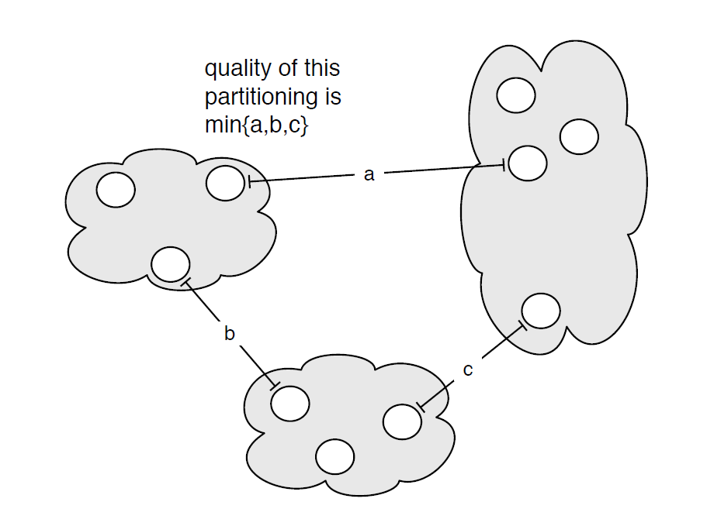
Single Linkage Clustering
[Zahn’71] Clustering via Minimum Spanning Tree:
k clusters: remove $k−1$ longest edges from MST
Maximizes minimum intercluster distance
[Kleinberg, Tardos]
Notes:
“”

Slide 20
Part 2: Clustering Vectors
Input: $v_{1},…, v_{n}∈ ℝ^{d}$
Feature vectors in ML, word embeddings in NLP, etc.
(Implicit) weighted graph of pairwise distances
Applications:
Same as before + Data visualization

Slide 21
Large geometric graphs
Graph algorithms: Dense graphs vs. sparse graphs
Dense: $S≫|V|$.
Sparse: $S≪|V|$.
Our setting:
Dense graphs, sparsely represented: O(n) space
Output doesn’t fit on one machine ($S≪ n$)
Today: $(1+ε)$-approximate MST [Andoni, Onak, Nikolov, Y.]
$d=2$ (easy to generalize)
$R=\log_{S}{n}\text{= }\text{O}\text{(1) }$rounds ($S=n^{Ω(1)}$)

Slide 22
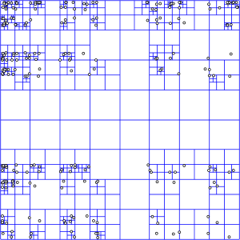
$O(log n)$-MST in $R=O(log n)$rounds
Assume points have integer coordinates $\left[0, …,Δ\right]$, where $Δ=O\left(n^{2}\right) .$
Impose an $O(log⁡n)$-depth quadtree
Bottom-up: For each cell in the quadtree
compute optimum MSTs in subcells
Use only one representative from each cell on the next level
Wrong representative:
O(1)-approximation per level

Slide 23
$εL$-nets
$εL$-net for a cell C with side length $L$:
Collection S of vertices in C, every vertex is at distance <= $εL$ from some vertex in S. (Fact: Can efficiently compute $ε$-net of size $O\left(\frac{1}{ε^{2}}\right))$
Bottom-up: For each cell in the quadtree
Compute optimum MSTs in subcells
Use $εL$-net from each cell on the next level
Idea: Pay only $O(εL$) for an edge cut by cell with side $L$
Randomly shift the quadtree: $\operatorname{Pr}\left[cut edge of length ℓ by L\right]∼ℓ/L$ – charge errors
Wrong representative:
O(1)-approximation per level
$$L$$
$$εL$$
$$L$$

Slide 24
$$Randomly shifted quadtree$$
Top cell shifted by a random vector in ${\left[0,L\right]}^{2}$
Impose a randomly shifted quadtree (top cell length $2Δ$)
Bottom-up: For each cell in the quadtree
Compute optimum MSTs in subcells
Use $εL$-net from each cell on the next level
Pay 5 instead of 4
Pr[$Bad Cut$] = $Ω$(1)
2
$$Bad Cut$$
1

Slide 25
$\left(1+ε\right)$-MST in $R=O(log n)$rounds
Idea: Only use short edges inside the cells
Impose a randomly shifted quadtree (top cell length $\frac{2Δ}{ε }$ )
Bottom-up: For each node (cell) in the quadtree
compute optimum Minimum Spanning Forests in subcells, using edges of length $≤εL$
Use only $ε^{2}L$-net from each cell on the next level
Sketch of analysis ($T^{∗}$ = optimum MST):
𝔼[Extra cost] =
𝔼$\text{[}\sum_{e∈T^{∗}}{\operatorname{Pr}\left[e is cut by cell with side L\right]⋅ εL} ]$
$$≤\left(ε log n \sum_{e∈T^{∗}}{d\left(e\right)}\right)=$$
$$ε log n⋅cost(T^{∗})$$
$L=Ω(\frac{1}{ε})$
2
Pr[$Bad Cut$] = $O(ε)$
1

Slide 26
$\left(1+ε\right)$-MST in $R=O(1)$rounds
$O(log n)$ rounds => O($\log_{S}{n}$) = O(1) rounds
Flatten the tree: ($\sqrt{M}×\sqrt{M}$)-grids instead of (2x2) grids at each level.
Impose a randomly shifted ($\sqrt{M}×\sqrt{M}$)-tree
Bottom-up: For each node (cell) in the tree
compute optimum MSTs in subcells via edges of length $≤εL$
Use only $ε^{2}L$-net from each cell on the next level
$$\sqrt{M}=n^{Ω(1)}$$
⇒

Slide 27
Single-Linkage Clustering [Y., Vadapalli]
Q: Single-linkage clustering from $(1+ε)$-MST?
A: No, a fixed edge can be arbitrarily distorted
Idea:
Run $O\left(\log{n}\right)$ times & collect all $(1+ε)$-MST edges
Compute MST of these edges using Boruvka
Use this MST for k-Single Linkage Clustering for all k
Overall: O(log n) rounds of MPC instead of O(1)
Q: Is this actually necessary?
A: Most likely yes, i.e. yes, assuming sparse connectivity is hard

Slide 28
Single-Linkage Clustering [Y., Vadapalli]
Conj 1: Sparse Connectivity requires $Ω(\log{|V|})$
Conj 2: “1 cycle vs. 2 cycles” requires $Ω(\log{|V|})$
Under $ℓ_{p}$-Distances:
Distance | Approximation | Hardness under Conjecture 1* | Hardness under Conjecture 2*
_{Hamming} | Exact | 2 | 3
$$ℓ_{1}$$ | $$(1+ε)$$ | 2 | 3
$$ℓ_{2}$$ | $$(1+ε)$$ | $$1.41 −ε$$ | $1.84 −ε$
$$ℓ_{∞}$$ | $$(1+ε)$$ | 2

Slide 29
Thanks! Questions?
Slides will be available on http://grigory.us
More about algorithms for massive data:
http://grigory.us/blog/
More in the classes I teach:

Slide 30
$\left(1+ε\right)$-MST in $R=O(1)$rounds
Theorem: Let $l$ = # levels in a random tree P
$$𝔼_{P}\left[ALG\right]≤\left(1+O\left(εld\right)\right)OPT$$
Proof (sketch):
$Δ_{P}(u,v)$ = cell length, which first partitions $(u, v)$
New weights: $w_{P}\left(u,v\right)={\left|\left|u −v\right|\right|}_{2}+εΔ_{P}\left(u,v\right)$
$${{\left|\left|u −v\right|\right|}_{2}≤𝔼_{P}[w}_{P}\left(u,v\right)]≤\left(1+O\left(εld\right)\right){\left|\left|u −v\right|\right|}_{2}$$
Our algorithm implements Kruskal for weights $w_{P}$
$$u$$
$$v$$
$$Δ_{P}\left(u,v\right)$$

Slide 31
Technical Details
$(1+ε)$-MST:
“Load balancing”: partition the tree into parts of the same size
Almost linear time locally: Approximate Nearest Neighbor data structure [Indyk’99]
Dependence on dimension d (size of $ε$-net is ${O\left(\frac{d}{ε}\right)}^{d})$
Generalizes to bounded doubling dimension

Slide 32
Algorithm for Connectivity: Setup
Data: $\text{n}$edges of an undirected graph.
Notation:
$π(v)$ $≡$unique id of $v$
$Γ(S)$ $≡$ set of neighbors of a subset of vertices S.
Labels:
Algorithm assigns a label $ℓ(v)$ to each $v$.
$L_{v}$ $≡$the set of vertices with the label $ℓ(v)$ (invariant: subset of the connected component containing $v$).
Active vertices:
Some vertices will be called active (exactly one per $L_{v}$).

Slide 33
Algorithm for Connectivity
Mark every vertex as active and let $ℓ(v)=π(v)$.
For phases $i=1,2,…,O(log⁡\text{n})$ do:
Call each active vertex a leader with probability 1/2. If v is a leader, mark all vertices in $L_{v}$ as leaders.
For every active non-leader vertex w, find the smallest leader (by $π$) vertex $w^{⋆}$ in $Γ(L_{w})$.
Mark w passive, relabel each vertex with label w by $w^{⋆}$.
Output: set of connected components based on $ℓ$.

Slide 34
Algorithm for Connectivity: Analysis
If $ℓ(u)=ℓ(v)$ then $u$ and $v$ are in the same CC.
Claim: Unique labels with high probability after $O(\log{N})$ phases.
For every CC # active vertices reduces by a constant factor in every phase.
Half of the active vertices declared as non-leaders.
Fix an active non-leader vertex $v$.
If at least two different labels in the CC of v then there is an edge $(v′,u)$ such that $ℓ(v)=ℓ(v′)$ and $ℓ(v′)≠ℓ(u)$.
$u$ marked as a leader with probability 1/2 $⇒$half of the active non-leader vertices will change their label.
Overall, expect 1/4 of labels to disappear.
After $O(\log{N})$ phases # of active labels in every connected component will drop to one with high probability

Slide 35
Algorithm for Connectivity: Implementation Details
Distributed data structure of size $O\left(\left|V\right|\right)$to maintain labels, ids, leader/non-leader status, etc.
O(1) rounds per stage to update the data structure
Edges stored locally with all auxiliary info
Between stages: use distributed data structure to update local info on edges
For every active non-leader vertex w, find the smallest leader (w.r.t $π$) vertex $w^{⋆}∈Γ(L_{w})$
Each (non-leader, leader) edge sends an update to the distributed data structure
Much faster with Distributed Hash Table Service (DHT) [Kiveris, Lattanzi, Mirrokni, Rastogi, Vassilvitskii’14]

Slide 36
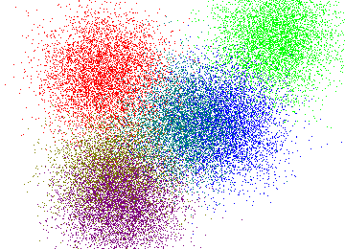
Problem 3: K-means
Input: $v_{1},…, v_{n}∈ ℝ^{d}$
Find $k$ centers $c_{1},…, c_{k}$
Minimize sum of squared distance to the closest center:
$$\sum_{i=1}^{n}{\min_{j=1}^{k}{||v_{i}−c_{j}||_{2}^{2} }}$$
$||v_{i}−c_{j}||_{2}^{2}=\sum_{t=1}^{d}{{\left(v_{it}−c_{jt}\right)}^{2}}$
NP-hard
$$⇒$$

Slide 37
K-means++ [Arthur,Vassilvitskii’07]
$C=\{c_{1},…, c_{t}\}$ (collection of centers)
$d^{2}\left(v,C\right)=\min_{j=1}^{k}{||v−c_{j}||_{2}^{2} }$
K-means++ algorithm (gives $O\left(\log{k}\right)$-approximation):
Pick $c_{1}$ uniformly at random from the data
Pick centers $c_{2}…, c_{k}$ sequentially from the distribution where point $v$ has probability
$$\frac{d^{2}\left(v,C\right)}{\sum_{i=1}^{n}{d^{2}(v_{i}, C)}}$$

Slide 38
K-means$||$ [Bahmani et al. ‘12]
Pick ${C=c}_{1}$ uniformly at random from data
Initial cost: $ψ=\sum_{i=1}^{n}{d^{2}(v_{i},c_{1})}$
Do $O(\log{ψ})$ times:
Add $O\left(k\right)$ centers from the distribution where point $v$ has probability
$$\frac{d^{2}\left(v,C\right)}{\sum_{i=1}^{n}{d^{2}(v_{i}, C)}}$$
Solve k-means for these O($k\log{ψ}$) points locally
Thm. If final step gives $α$-approximation
$⇒$ $O(α)$-approximation overall

Slide 39
Problem 2: Correlation Clustering
Inspired by machine learning at
Practice: [Cohen, McCallum ‘01, Cohen, Richman ’02]
Theory: [Blum, Bansal, Chawla ’04]

Slide 40
Correlation Clustering: Example
Minimize # of incorrectly classified pairs:
# Covered non-edges + # Non-covered edges
4 incorrectly classified =
1 covered non-edge +
3 non-covered edges

Slide 41
Approximating Correlation Clustering
Minimize # of incorrectly classified pairs
$≈20000$-approximation [Blum, Bansal, Chawla’04]
[Demaine, Emmanuel, Fiat, Immorlica’04],[Charikar, Guruswami, Wirth’05], [Ailon, Charikar, Newman’05] [Williamson, van Zuylen’07], [Ailon, Liberty’08],…
$≈2$-approximation [Chawla, Makarychev, Schramm, Y. ’15]
Maximize # of correctly classified pairs
($1−ε$)-approximation [Blum, Bansal, Chawla’04]

Slide 42
Correlation Clustering
One of the most successful clustering methods:
Only uses qualitative information about similarities
# of clusters unspecified (selected to best fit data)
Applications: document/image deduplication (data from crowds or black-box machine learning)
NP-hard [Bansal, Blum, Chawla ‘04], admits simple approximation algorithms with good provable guarantees

Slide 43
Correlation Clustering
More:
Survey [Wirth]
KDD’14 tutorial: “Correlation Clustering: From Theory to Practice” [Bonchi, Garcia-Soriano, Liberty] http://francescobonchi.com/CCtuto_kdd14.pdf
Wikipedia article: http://en.wikipedia.org/wiki/Correlation_clustering

Slide 44
Data-Based Randomized Pivoting
3-approximation (expected) [Ailon, Charikar, Newman]
Algorithm:
Pick a random pivot vertex $v$
Make a cluster $v∪N(v)$, where $N\left(v\right)$ is the set of neighbors of $v$
Remove the cluster from the graph and repeat

Slide 45
Data-Based Randomized Pivoting
Pick a random pivot vertex $p$
Make a cluster $p∪N(p)$, where $N\left(p\right)$ is the set of neighbors of $p$
Remove the cluster from the graph and repeat
8 incorrectly classified =
2 covered non-edges +
6 non-covered edges

Slide 46
Parallel Pivot Algorithm
$(3+ε)$-approx. in $O(\log^{2}{n}/ ε)$ rounds [Chierichetti, Dalvi, Kumar, KDD’14]
Algorithm: while the graph is not empty
$D=$ current maximum degree
Activate each node independently with prob. $ε/D$
Deactivate nodes connected to other active nodes
The remaining nodes are pivots
Create cluster around each pivot as before
Remove the clusters

Slide 47
Parallel Pivot Algorithm: Analysis
Fact: Halves max degree after $\frac{1}{ε}\log{n}$ rounds
$⇒$ terminates in $O\left(\frac{\log^{2}{n}}{ε}\right)$ rounds
Fact: Activation process induces close to uniform marginal distribution of the pivots
$⇒$ analysis similar to regular pivot gives ($3+ε$)-approximation

