Slide 1
Learning from Tuples
?
?
Grigory Yaroslavtsev
http://grigory.ai

Slide 2
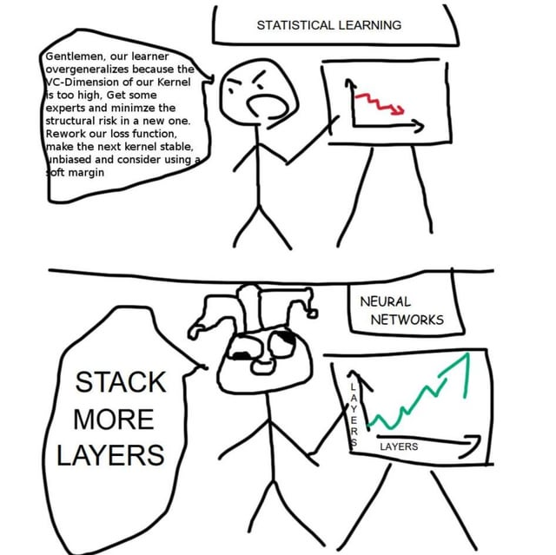
How true is this meme?
Both can be true…

Slide 3
Tree Learning Optimal Algorithms and Sample Complexity
Dmitrii
Avdiukhin
Grigory Yaroslavtsev
Danny Vainstein
Orr Fischer
Sauman Das
Faraz Mirza

Slide 4
Tree learning
Bioinformatics
Phylogenetics
Applications
Statistics
Image/text classification
Visualization

Slide 5
“Odd one out” constraints
[
,
|
]
$$\left(a,b,c\right)→\left[a,c | b\right]$$

Slide 6
Tree learning via “odd one out” constraints
Constraints
Some possible trees
Some impossible trees

Slide 7
Learning problem: Sample Complexity
Problem
Given $n$ elements
Given $m$ constraints sampled from a distribution $D$
Given a triple from $D$, predict its constraint
PAC-learning!
Goal
Error rate on unseen constraints $≤ε$
The algorithm must succeed with probability $≥1−δ$
?
Question
How large should $m$ be?

Slide 8
Our results
Theorem
Sample complexity $m=Θ\left(\frac{n}{ε^{2}}⋅polylog\left(\frac{1}{ε},\frac{1}{δ}\right)\right)=\tilde{Θ}\left(\frac{n}{ε^{2}}\right)$
Discussion
Tight: linear dependence on $n$
For constant $ε$ and $δ$, better than $Θ\left(n\log{n}\right)$ (natural via the probabilistic method)
Will outline generalizations later

Slide 9
PAC Learning
Classification Problem
Each input from $X$ has a label from $Y$, i.e. exists $f:X→Y$
Want to find $f$
Hypothesis space
$H$ is a set of considered functions $X→Y$ (e.g. tree labelings)
Realizable case: $f∈H$
Agnostic case: $f∉H, h^{∗}=argmin_{g∈H} err(f,g)$
Probably Approximately Correct Learning
Given a set of samples $\left(x_{1},f\left(x_{1}\right)\right),…,\left(x_{m},f\left(x_{m}\right)\right)$
The algorithm must succeed with probability $≥1−δ$
Realizable:
$$err\left(h\right)≤ε$$
Agnostic:
$$err\left(h\right)≤err\left(h^{∗}\right)+ε$$

Slide 10
PAC Learning: Algorithm
Algorithm
Empirical risk minimizer
Realizable case
Find a tree satisfying all known constraints [Aho et al.`81], …, [Thorup`99]
Agnostic case
Find a tree satisfying the largest number of known constraints
c
d
c
b
a
b
a
b
d
a
b
a
d
d
c
c
d
a
b
d
a
b
a
c
a
c

Slide 11
PAC Learning: Sample Complexity
Sample complexity
Linear dependence on dimension
Binary case: VC dimension
Non-binary case: Natarajan dimension
Key technical result
For Tree Learning, the Natarajan dimension is $n−2$

Slide 12
VC dimension (2 label case)
...
1
2
3
4
8
9
2
3
8
2
3
8
2
3
8
$$S=\{ \}$$
2
3
8
$2^{|S|}$ labelings
2
3
8
2
3
8
2
3
8
$S$ is VC-shattered
2
3
8
All $2^{|S|}$ labelings possible in $H$
2
3
8
VC-dimension
The cardinality of the largest VC-shattered $S$
Sample complexity: $\tilde{O}\left(\frac{VCDim}{ε}\right)$ for realizable, $\tilde{O}\left(\frac{VCDim}{ε^{2}}\right)$ for agnostic

Slide 13
Natarajan dimension (multi-label case)
...
1
2
3
4
8
9
2
3
8
111 agreement
$$S=\{ \}$$
2
3
8
112 agreement
2
3
8
2
3
8
121 agreement
1st Labeling:
2
3
8
$S$ is Natarajan-shattered
2
3
8
$2^{|S|}$ labelings
2nd Labeling:
All $2^{|S|}$ agreements in $H$
($∃$ choice of 2 labelings with $2^{|S|}$ agreements)
2
3
8
2
3
8
2
3
8
212 agreement
2
3
8
221 agreement
2
3
8
222 agreement
Natarajan dimension
The cardinality of the largest Natarajan-shattered $S$
Natarajan dimension $≥$ VC-dimension
Sample complexity: $\tilde{O}\left(\frac{NDim}{ε}\right)$ for realizable, $\tilde{O}\left(\frac{NDim}{ε^{2}}\right)$ for agnostic

Slide 14
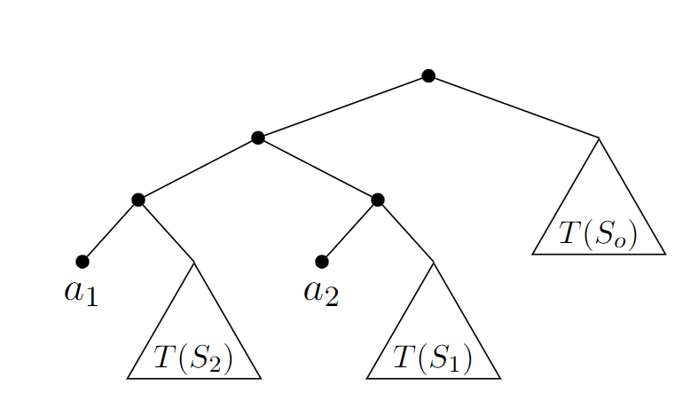
Natarajan dimension: Lower Bound
Natarajan dimension is $≥n−2$
$$\left(a_{1},a_{2},a_{3}\right), \left(a_{1},a_{2},a_{4}\right),\left(a_{1},a_{2},a_{5}\right),…(a_{1},a_{2},a_{n})$$
c
a
b
$$[ab|c]$$
$$[a_{1}a_{2}|a_{i}]$$
$$[a_{1}a_{i}|a_{2}]$$
$$[a_{i}a_{2}|a_{1}]$$

Slide 15
Natarajan dimension: Upper Bound
c
d
c
d
The top split can’t cut an edge!
a
b
a
b
a
b
a
b
c
a
d
d
b
a
c
d
d
d
d
b
a
c
b
c
a
c
b
c
c
d
a
b
a
b
c
c
a
d
d
a
b
b
c
c
d
d
a
c
b
c
a
b
a
b

Slide 16
Tree Building
Algorithm
Top-down approach
When splitting $S$, build connected components
Split $S$ according to the connected components
If $S$ is connected, the constraints are contradictory
…
S
…
Analysis
If the constraints are contradictory, fails
If the constraints are not contradictory, always succeeds
Natarajan Shattering
a
How to build contradictory orientations?
$n−1$ edges are required to connect $n$ items
b
c
d

Slide 17
Choosing contradictory constraints
!
Main Idea
Let’s fix a set of $n−1$ triplets
Can always select constraints so that there exists a set $S$ connected by the edges produced by constraints in $S$
Critical Set
Consider any set $S$ with the following properties:
There are at least $\left|S\right|−1$ triplets in $S$
Such $S$ has the smallest cardinality
(For $n−1$ triplets, such $S$ exist)
Example
$\left(a,d,b\right),\left(a,b,c\right),(a,c,d)$
$S=\left\{a,b,c,d\right\}$
$S$ has $\left|S\right|−1$ triplets

Slide 18
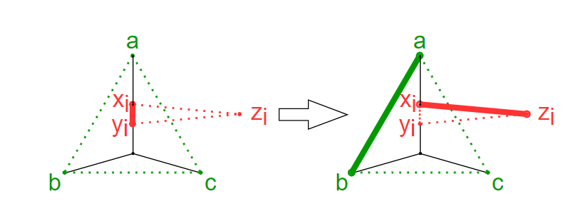
Proof Outline
!
Critical set $\left|S\right|$ has $≥\left|S\right|−1$ triplets
Select orientations which generate the maximum forest
If not connected, there is an unused triplet
Reorient constraints so that the forest increases
Natarajan shattering: reorientations chosen from 2 labelings
A few pages of case analysis later...

Slide 19
Generalizations

Slide 20
Non-Binary Trees
$$[a|b|c]$$
Our result is exactly the same

Slide 21
Non-realizable case
Problem
No tree corresponding to the constraints, i.e. $f∉H$
Still want to minimize the error rate
Error rate $≤\min_{h^{∗}∈H}{err(h^{∗})}+ε$
Same result
Sample complexity is linear in the Natarajan dimension
Algorithm: Empirical Risk Minimizer
(Caveat: NP-hard to get slightly better than $O(n)$ approximation for ERM [Chester et al.`13])

Slide 22
Online setting
Settings
Have a stream of triplets
For each triplet, want to predict the label
After the prediction, know the correct answer
Want to minimize the number of errors
Result
Realizable case: $Θ\left(n log n\right)$ mistakes (Littlestone dimension)
Agnostic case: $\tilde{O}(\sqrt{T LDim} )$ regret (also Littlestone dimension)

Slide 23
Conclusion
Tight sample bounds for tree learning
For binary/non-binary trees
For $k$-tuples for constant $k$
For realizable/non-realizable case
For online settings
Non-uniform distribution on triplets
?
Open questions:
Under which natural assumptions the efficient empirical risk minimizer for non-realizable case exists?
Improved sample complexity for adaptive queries?

Slide 24
Optimal Sample Complexity of Contrastive Learning
Noga
Alon
Dmitrii
Avdiukhin
Dor
Elboim
Orr Fischer
Grigory Yaroslavtsev

Slide 25
Contrastive Learning
$ρ$(
,
) >
$ρ$(
,
)

Slide 26
Contrastive Learning
$ρ$(
,
) >
$ρ$(
,
)
$ρ$(
,
) >
$ρ$(
,
)
$ρ$(
,
) >
$ρ$(
,
)

Slide 27
Contrastive Learning
$ρ$(
,
) >
$ρ$(
,
)?
$ρ$(
,
) >
$ρ$(
,
)?

Slide 28
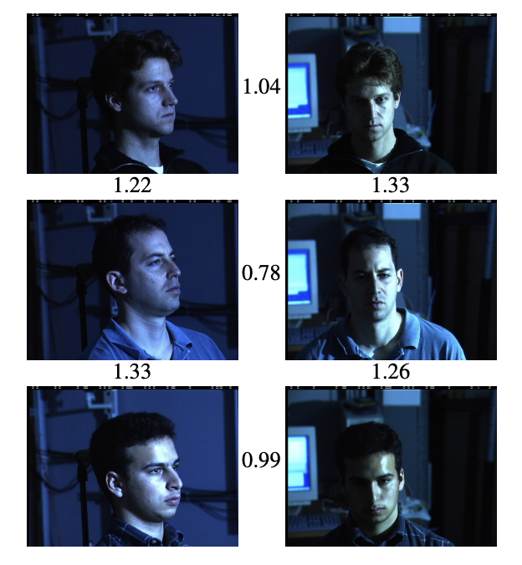
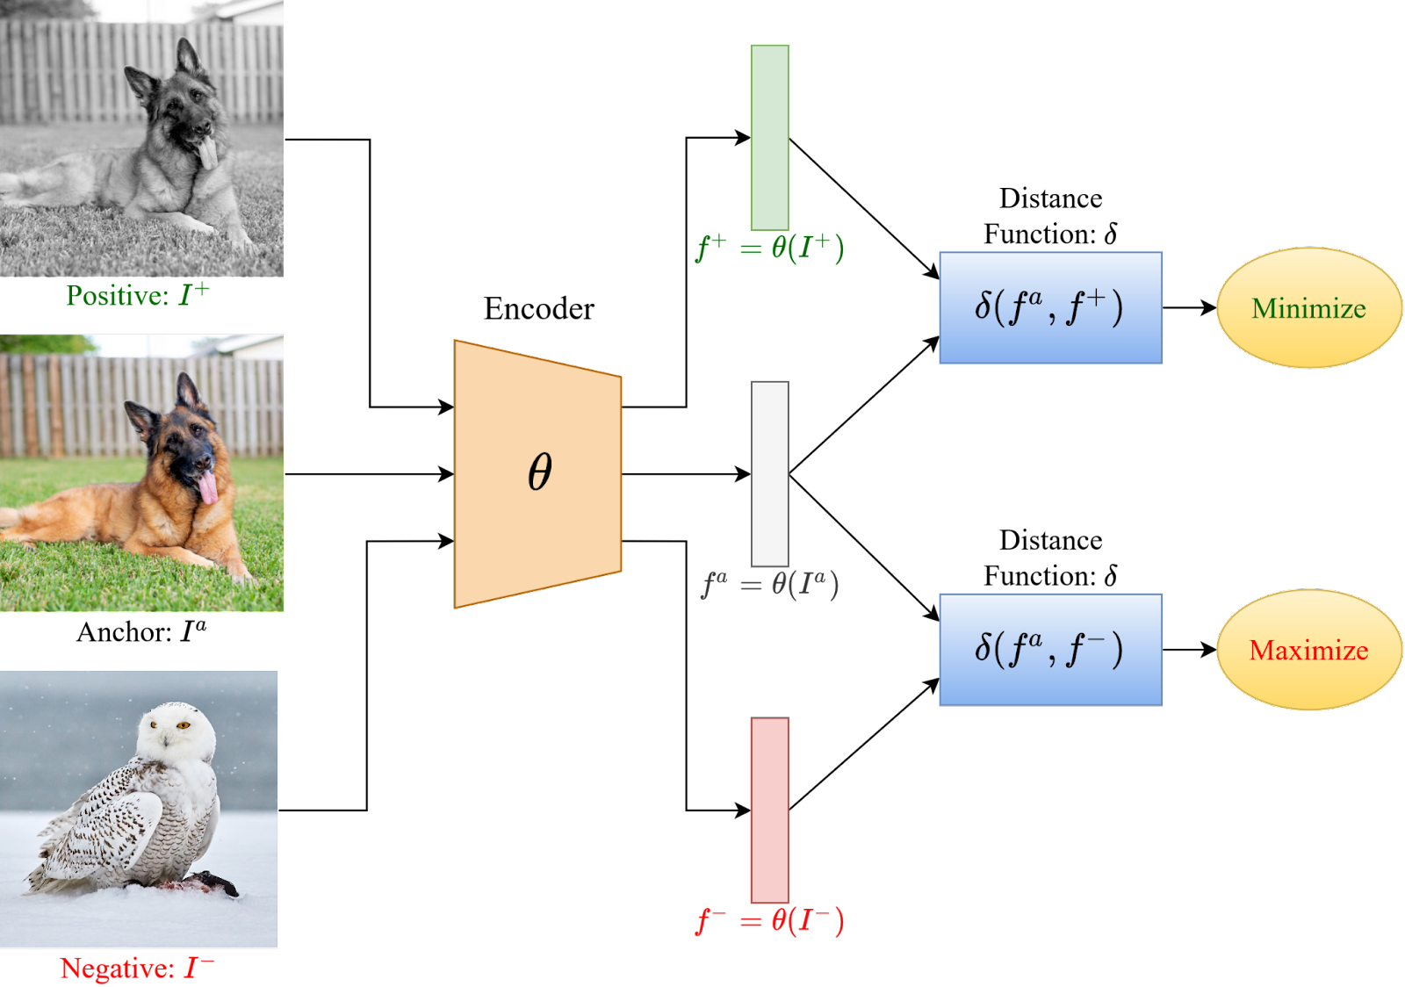
Applications
Contrastive learning is extremely popular (see Lilian Weng, OpenAI): https://lilianweng.github.io/posts/2021-05-31-contrastive
Image: Google’s Facenet, 13K+ citations
Image: V7labs

Slide 29
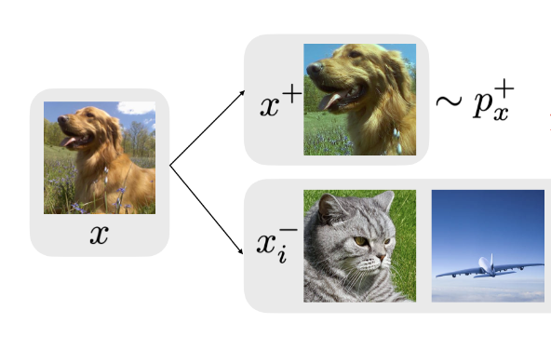
Contrastive Learning
Q: # labeled samples required to get low prediction error?
Given samples $\left(x,x_{1},…x_{k+1}\right)∼D$
How many tuples do we need to predict the next label?
$$\left(x,x_{1},…x_{k+1}\right)∼D→\left(x,x^{+},x_{1}^{−}…x_{k}^{−}\right)$$
How many triples do we need to predict the next triple?
$$\left(x,y,z\right)∼D→\left(x,z^{+},y^{−} \right)$$
Image: Lilian Weng, [Chuang et al, 20]

Slide 30
General Distance Functions
How many triples do we need to predict the next triple?
$$\left(x,y,z\right)∼D→\left(x,z^{+},y^{−} \right)$$
Binary classification problem: VC-dimension = ?
Theorem: If $ρ$ is an arbitrary distance function then:
VC-dimension = $Θ\left(n^{2}\right)$
Lower bound holds for metric $ρ$.

Slide 31
General Distance Functions
Theorem: If $ρ$ is an arbitrary distance function then:
VC-dimension = $Θ\left(n^{2}\right)$
$≥n^{2}$queries $⇒$ at least $n$ queries with the same anchor:
$$\left(x,y_{1}, z_{1}\right)$$
$$\left(x,y_{2}, z_{2}\right)$$
…
$$\left(x,y_{n}, z_{n}\right)$$
Graph with edges $\left(y_{i}, z_{i}\right)$ has a cycle
$ρ\left(x,a\right)<ρ\left(x,b\right)<…<ρ\left(x,a\right)⇒$not all labelings possible
$$x$$
a
$$<$$
b
$$<$$
d
c

Slide 32
$ℓ_{p}$-distances
Theorem: If $ρ$ is $ℓ_{p}$-distance in $ℝ^{d}$ for integer $p≥1$:
VC-dimension = $\tilde{Θ}\left(nd\right)$
$$p$$ | Upper bound | Lower bound
$p=2$ and all even $p$ | $$O(nd)$$ | $$Ω(nd)$$
$p=1$ and all odd $p$ | $O(nd\log{nd})$ for any $d$ $O(n)$ for $d=O(1)$ | $$Ω(nd)$$

Slide 33
$ℓ_{p}$-distances, even $p$
Theorem: If $ρ$ is $ℓ_{p}$-distance in $ℝ^{d}$ for even $p≥2$:
VC-dimension = $O\left(nd\right)$
Consider constraints imposed by a query $(x,y,z)$:
$$\sum_{i=1}^{d}{{\left(x_{i}−y_{i}\right)}^{p}}−\sum_{i=1}^{d}{{\left(x_{i}−z_{i}\right)}^{p}}≶0$$
Overall: $m$ polynomials of degree $p$ in$nd$ variables
Q: How many sign patterns can $P_{1},P_{2},…,P_{m}$ have?

Slide 34
$ℓ_{p}$-distances, even $p$
Overall: $m$ polynomials $P_{1},P_{2},…,P_{m}$ of degree $p$ in $nd$ variables
Theorem (Warren’68).
Let $m≥ℓ≥2$ be integers and let $P_{1},P_{2},…,P_{m}$ be real polynomials on $ℓ$ variables, each of degree $≤k.$ Let $U\left(P_{1},…,P_{m}\right)=\left\{x∈R^{ℓ}\right|∀i:P_{i}\left(x\right)≠0\}$. The number of connected components in $U\left(P_{1},…,P_{m}\right)$ is $≤{\left(\frac{4ekm}{ℓ}\right)}^{ℓ}$
Same holds for # of sign patterns, so:
$$2^{m}≤{\left(\frac{4epm}{nd}\right)}^{nd}⇒m=O(nd)$$
!

Slide 35
$ℓ_{p}$-distances, odd $p$
Overall: $m$ polynomials $P_{1},P_{2},…,P_{m}$ of degree $p$ in$nd$ variables
For odd $p$ each polynomial $→2^{2d}$ polynomials:
$${\left|x_{1}−y_{1}\right|}^{p}+…{\left|x_{d}−y_{d}\right|}^{p}−{\left|x_{1}−z_{1}\right|}^{p}−…{\left|x_{d}−z_{d}\right|}^{p}≶0$$
$${±\left(x_{1}−y_{1}\right)}^{p}+…{±\left(x_{1}−y_{d}\right)}^{p}−{±\left(x_{1}−z_{1}\right)}^{p}−…{±\left(x_{d}−z_{d}\right)}^{p}≶0$$
By [Warren’68] # of sign patterns is:
$2^{m}≤{\left(\frac{4epm2^{2d}}{nd}\right)}^{nd}⇒m=O(n)$ for constant$d$

Slide 36
$ℓ_{p}$-distances, odd $p$
$d=1$, $p=1$:
$$\left|x_{1}−y_{1}\right|+…{\left|x_{n}−y_{n}\right|}^{}−{\left|x_{1}−z_{1}\right|}^{}−…{\left|x_{n}−z_{n}\right|}^{}≶0$$
Fix one of the $n!$ permutations of points on the line
This determines the sign of each absolute value, so we have:
$α_{11}x_{1}+α_{12}x_{2}+…α_{1n}x_{n}$ $≶0$
$α_{21}x_{1}+α_{22}x_{2}+…α_{2n}x_{n}$ $≶0$
…
$α_{m1}x_{1}+α_{m2}x_{2}+…α_{mn}x_{n}$ $≶0$

Slide 37
$ℓ_{1}$-distance
$±(α_{11}x_{1}+α_{12}x_{2}+…α_{1n}x_{n})$ $<0$
$±(α_{21}x_{1}+α_{22}x_{2}+…α_{2n}x_{n})$ $<0$
…
$±(α_{m1}x_{1}+α_{m2}x_{2}+…α_{mn}x_{n})$ $<0$
Q: Pick signs at random, what is the probability we can’t get 0?
!
Theorem (Wendel’62).
Let $v_{1},…, v_{m}$ be vectors in $ℝ^{n}$ with uniformly random signs $σ_{1},…,σ_{m}:$
$\underset{σ_{1},…,σ_{m}}{Pr}⁡$ [convex hull of ${{\{σ}_{i}v}_{i}\}$ doesn’t contain zero] $≤\frac{1}{2^{m−1}}\sum_{k=1}^{n}{\left({m−1 \atop k}\right)}$

Slide 38
$ℓ_{1}$-distance
!
Theorem (Wendel’62).
Let $v_{1},…, v_{m}$ be vectors in $ℝ^{n}$ with uniformly random signs $σ_{1},…,σ_{m}:$
$\underset{σ_{1},…,σ_{m}}{Pr}⁡$ [convex hull of ${{\{σ}_{i}v}_{i}\}$ doesn’t contain zero] $≤\frac{1}{2^{m−1}}\sum_{k=1}^{n}{\left({m−1 \atop k}\right)}$
Fix $m=Cn\log{n}$and take a union bound over $n!$ permutations:
there exists a permutation and a set of signs such that 0 < 0.
VC-dimension = $O(n\log{n})$
VC-dimension = $O(nd\log{nd})$ (same proof for $d$ permutations)

Slide 39
Other Results
Almost optimal bounds for other settings
Cosine similarity: same bounds
For $k$negatives: same bounds with extra $\log{k}$ (via Natarajan)
Quadruplet learning $d\left(x,y\right)≶d(z,w)$: same bounds
For tree metrics: $\tilde{O}(n)$ bound
For well-separated $ℓ_{2}$, i.e. $d(x, z^{−})>(1+α)d(x,y^{+})$:
Upper bound: $\tilde{O} \left(\frac{n}{α^{2}}\right)$ (for bounded aspect ratio)
Lower bound: $Ω\left(\frac{n}{α}\right)$

Slide 40
Open Problems
Optimal bounds for $ℓ_{p}$ for any odd $d$?
Optimal sample complexity for well-separated queries?

Slide 41
Thank you!
?
?

Slide 42
Query complexity
Trivial upper bound
Given constraints for all $\left({n \atop 3}\right)$ triplets, we can recover the tree
Trivial lower bound
We need $Ω(n)$ constraints to see every element
Adaptive queries:
Non-adaptive queries:
$Θ(n\log{n})$ samples are necessary and sufficient
[Kannan et al.`96]
$Ω(n^{3})$ lower bound
[Emamjomeh-Zadeh & Kempe`18]

Slide 43
Natarajan dimension: Upper Bound
$$\left(a,b,c\right),\left(a,c,d\right),\left(a,d,b\right)$$
c
d
b
a
b
a
c
a
d
Consider the top-level cut in the tree
Can’t separate $a$ from $b$ (violates first constraint)
Can’t separate $a$ from $c$ (violates second constraint)
Can’t separate $a$ from $d$ (violates third constraint)
The constraints are contradictory
In fact, a shattered set of $n−1$ triplets doesn’t exist!

Slide 44
Practical HC algorithms
Bottom-up approaches
E.g. agglomerative clustering
Require pairwise distances/similarities
Top-down approaches
Various heuristics for the top-level cut
Require pairwise distances/similarities
... or Euclidean vectors
!
Problem
Distances/similarities might be not available

Slide 45
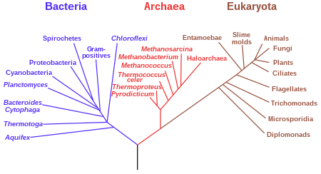
Application: phylogenetic tree

Slide 46
Almost correct tree
Recall: Non-adaptive queries
$Ω(n^{3})$ lower bound to recover the correct tree
Constraints
Almost correct tree
✓
✓
✓
Error rate $ε=\frac{1}{4}$

Slide 47
Classification in HC settings
Inputs:
a
b
c
Labels:
c
a
b
a
b
c
b
a
c
Hypothesis space: constraints induced by HC trees
a
b
c
c
d
c
b
a
b
d
a
b
a
b
d
a
b
a
d
c
a
c
d
d
d
a
b
d
d
b
c
d
a
c
b
c
a
c
b
c

Slide 48
Naive generalization of VC dimension
...
1
2
3
4
8
9
2
3
2
3
2
3
$$S=\{ \}$$
2
3
$S$is “VC-shattered”
2
3
${\left|Y\right|}^{|S|}$ labelings
2
3
If all ${|Y|}^{|S|}$ labelings are possible in $H$
2
3
2
3
2
3
2
3
Doesn’t work!

Slide 49
Non-binary trees
!
Connectivity
Generate edges as before
If $a$ and $b$ are connected, replace $[a|b|c]$ with edge $(a,c)$
Repeat until convergence
Algorithm
Same as before
!
Critical set
Same as before: $S$ with $≥\left|S\right|−1$ triplets

Slide 50
$k$-tuples
Settings
Constraints on $k$ elements
Constraint is a tree with $k$ leaves
If the constraint separates $c$ from $a$ and $b$, then the tree must separate $c$ from $a$ and $b$
Result
The Natarajan dimension is between $n−k$ and $n$
Linear dependence on $n$ for constant $k$
Proof idea
Upper bound: every $k$-tuple constraint has a triplet constraint
Lower bound: same idea as for triplets

